Slide 1
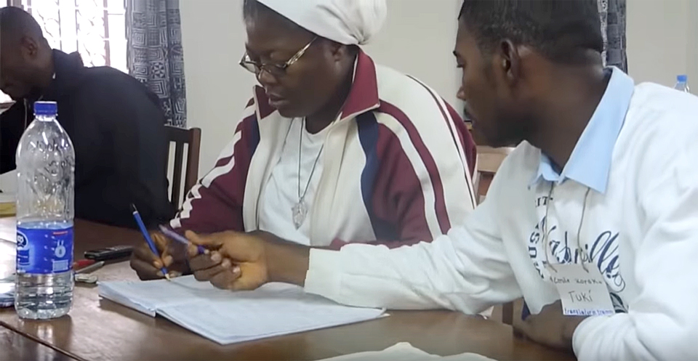
MAST Drafting Steps

Slide 2
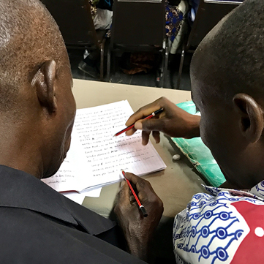

The 8 Steps of MAST
Drafting Steps
Checking Steps
Consume
Verbalize
Chunk
Blind Draft
Self-edit
Peer-edit
Key Word Check
Verse-by-Verse Check

Slide 3


Drafting Steps Defined
1
2
3
4
Consume
Verbalize
Chunk
Blind Draft
Think about what the passage means
Summarize the passage to someone in your language
Break the passage down into smaller pieces based on meaning
Draft each chunk from memory
5–7 min.
2–3 min.
1–4 verses
no source text

Slide 4
Try it
Are you surprised by what you can do?
What is difficult?
Are you ready for the next steps?

Slide 5


